Slide 1
4-Bit Ripple
Carry Adder
1011
+0110
=10001
DIGITAL LOGIC DESIGN
Built from full adders: working and carry propagation delay
2620030114-Vyshnavi
2620030112-Aviyah
2620030088-Yutesh
2620030138-Krishna
Notes:
Introduce the topic: a 4-bit adder made by chaining four full adders. The example in the corner (11 + 6 = 17) is worked through in detail later.

Slide 2
Problem Statement
SECTION 1
Design a 4-bit ripple carry adder using full adders, explain how it works, and find its carry propagation delay.
Design
Explain
Analyse
Chain four 1-bit full adders to add two 4-bit numbers.
Trace how each carry moves from bit 0 up to bit 3.
Work out the worst-case delay and how it grows with word length.
4-Bit Ripple Carry Adder
2
Notes:
State the three goals: design the adder, explain how it works, and analyse the carry propagation delay. Each goal has its own slides later.

Slide 3
Full Adder Truth Table
BUILDING BLOCK
A | B | Cin | Sum | Cout
0 | 0 | 0 | 0 | 0
0 | 0 | 1 | 1 | 0
0 | 1 | 0 | 1 | 0
0 | 1 | 1 | 0 | 1
1 | 0 | 0 | 1 | 0
1 | 0 | 1 | 0 | 1
1 | 1 | 0 | 0 | 1
1 | 1 | 1 | 1 | 1
SUM BIT
Sum = A ⊕ B ⊕ Cin
CARRY OUT
Cout = A·B + Cin·(A ⊕ B)
Cout is 1 whenever at least two of the three inputs are 1. ⊕ means XOR.
4-Bit Ripple Carry Adder
3
Notes:
A full adder adds three bits: A, B and the carry-in from the previous stage. It produces a sum bit and a carry-out. Read the truth table row by row and point out that Cout is 1 in the four rows with two or more 1s.

Slide 4
Full Adder from Gates
DESIGN
1
2
3
First half adder
Second half adder
OR gate
P = A ⊕ B
G = A·B
Sum = P ⊕ Cin
T = P·Cin
Cout = G + T
2 XOR + 2 AND + 1 OR = 5 gates per full adder
Cin reaches Cout through one AND and one OR (2 gate delays) and reaches Sum through one XOR (1 gate delay).
4-Bit Ripple Carry Adder
4
Notes:
Two half adders plus an OR gate make one full adder. P is the propagate signal and G is the generate signal. The path from Cin to Cout is only an AND followed by an OR, which is why each ripple stage costs 2 gate delays.

Slide 5


4-Bit Ripple Carry Adder
DESIGN
A3 B3
A2 B2
A1 B1
A0 B0
FA3
FA2
FA1
FA0
Cout
C3
C2
C1
Cin=0
S3
S2
S1
S0
Each stage's Cout feeds the next stage's Cin. FA0 takes Cin = 0.
4-Bit Ripple Carry Adder
5
Notes:
FA0 handles the least significant bits and FA3 the most significant. The carry (orange) travels right to left, one stage at a time, which is why the adder is called a ripple carry adder. Inputs are A3..A0 and B3..B0; outputs are S3..S0 and the final carry Cout.

Slide 6
Design Methodology
SECTION 2
1
Define the ports
Inputs A3–A0, B3–B0, Cin. Outputs S3–S0, Cout.
2
Derive the equations
Read Sum and Cout from the full adder truth table.
3
Build one full adder
Two XOR, two AND and one OR gate as a Logisim sub-circuit.
4
Chain four copies
Wire each Cout into the next Cin. Tie the first Cin to 0.
5
Test and time it
Run input vectors, then count gate delays on the carry path.
4-Bit Ripple Carry Adder
6
Notes:
This is the bottom-up method: derive the 1-bit cell from its truth table, verify it, then replicate it four times. The same five steps are followed in the Logisim demo.

Slide 7
Worked Example: 1011 + 0110
WORKING
Stage | A | B | Cin | Sum | Cout
FA0 | 1 | 0 | 0 | 1 | 0
FA1 | 1 | 1 | 0 | 0 | 1
FA2 | 0 | 1 | 1 | 0 | 1
FA3 | 1 | 0 | 1 | 0 | 1
C1 = 0 → C2 = 1 → C3 = 1 → C4 = 1
S3 S2 S1 S0 = 0001 and Cout = 1, so the result is 10001 (11 + 6 = 17).
4-Bit Ripple Carry Adder
7
Notes:
Take A = 1011 (11) and B = 0110 (6) with Cin = 0. FA0 gives sum 1 and no carry. FA1 adds 1 + 1 and produces sum 0 with carry 1. FA2 adds 0 + 1 + carry 1 and produces sum 0 with carry 1. FA3 adds 1 + 0 + carry 1 and produces sum 0 with carry 1. The final carry becomes the fifth bit, giving 10001 = 17.

Slide 8
Carry Propagation Delay
ANALYSIS
Stage | Carry ready | Sum ready
FA0 | C1 at 3 | S0 at 2
FA1 | C2 at 5 | S1 at 4
FA2 | C3 at 7 | S2 at 6
FA3 | C4 at 9 | S3 at 8
9
gate delays from inputs to Cout in the worst case
T = 2n + 1
n = number of bits
Times are in gate delays, with A and B stable at t = 0 and Cin = 0.
Each extra stage adds 2 gate delays: one AND, then one OR.
4-Bit Ripple Carry Adder
8
Notes:
Count gate delays. In FA0, A and B go through an XOR (1), then an AND with Cin (2), then the OR (3), so C1 is ready at 3. After that, every stage only adds the AND and OR on the Cin-to-Cout path, so C2 is at 5, C3 at 7 and C4 (Cout) at 9. The most significant sum bit S3 needs C3 plus one XOR, so it is ready at 8. In general Cout is ready after 2n + 1 gate delays, so the delay is proportional to the number of bits. In real hardware, multiply by the delay of one gate.

Slide 9
Delay Grows with Word Length
ANALYSIS
Worst-case delay to Cout, in gate delays (2n + 1)
4-bit
9
8-bit
17
16-bit
33
32-bit
65
Worst case
Faster option
A carry from bit 0 must ripple through every stage, as in 1111 + 0001.
Carry-lookahead adders compute carries in parallel, at the cost of extra gates.
4-Bit Ripple Carry Adder
9
Notes:
The delay is linear in the number of bits: 9, 17, 33 and 65 gate delays for 4, 8, 16 and 32 bits. That is the main weakness of the ripple carry adder. For small widths it is cheap and simple; for wide adders designers use carry-lookahead or similar schemes.

Slide 10
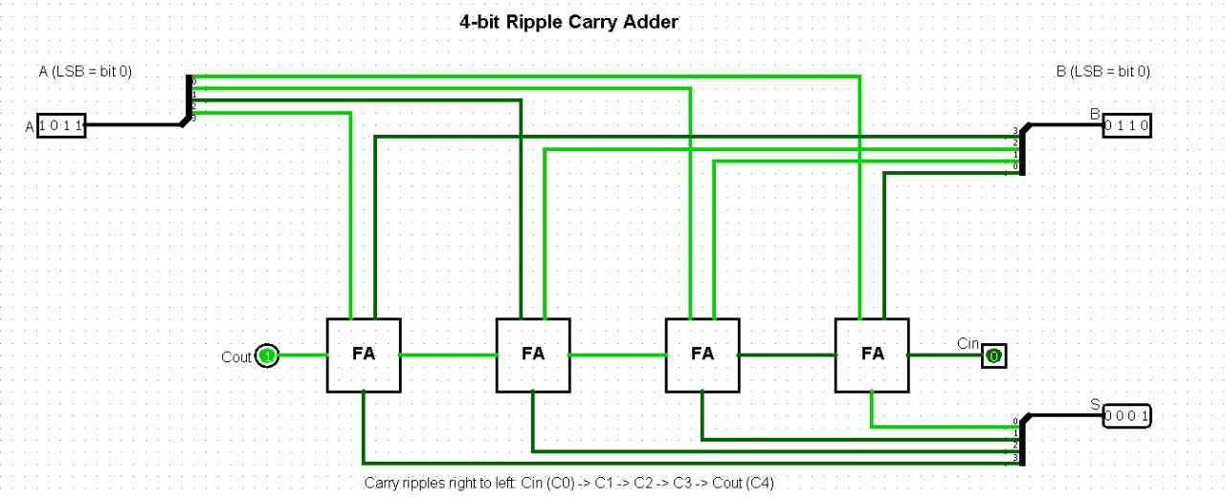
Demo in Logisim
SECTION 3
Create a FullAdder sub-circuit with inputs A, B, Cin and outputs Sum, Cout.
Wire two XOR, two AND and one OR gate as per the equations.
In the main circuit, place four FullAdder blocks in a row.
Wire each Cout to the next Cin. Tie the first Cin to 0.
Add pins A, B, S and Cout, then toggle inputs with the Poke tool.
[Logisim circuit screenshot]
Replace this box with your circuit image or demo recording
4-Bit Ripple Carry Adder
10
Notes:
Switch to the live Logisim demo here. Build or open the FullAdder sub-circuit first, then show the 4-bit circuit. Use the Poke tool to toggle A and B and read S and Cout. The next slide lists the test cases to run.

Slide 11
Test Cases for the Demo
DEMO
A | B | Sum | Cout | What to watch
0000 (0) | 0000 (0) | 0000 | 0 | all zeros
0001 (1) | 0001 (1) | 0010 | 0 | single carry
0111 (7) | 0001 (1) | 1000 | 0 | carry reaches bit 3
1011 (11) | 0110 (6) | 0001 | 1 | worked example
1111 (15) | 0001 (1) | 0000 | 1 | worst-case ripple
1111 (15) | 1111 (15) | 1110 | 1 | maximum sum
All tests use Cin = 0. Cout = 1 means the result needs a fifth bit.
4-Bit Ripple Carry Adder
11
Notes:
Run these inputs in Logisim and compare S and Cout with the table. The 1111 + 0001 case is the worst case because the carry has to ripple through all four stages before the result settles.

Slide 12
Conclusion
SUMMARY
A 4-bit ripple carry adder is easy to build. Its limit is the carry chain.
Simple
Slow carry
Faster options
Four full adders of 5 gates each, so 20 gates in total.
The carry ripples stage by stage: 9 gate delays for 4 bits, 2n + 1 in general.
Carry-lookahead adders trade extra gates for much lower delay.
4-Bit Ripple Carry Adder
12
Notes:
Recap: the design is simple and uses few gates, the worst-case delay grows linearly with the number of bits, and carry-lookahead is the standard fix when speed matters.

Slide 13
GitHub Repository
SECTION 4
https://github.com/kalidasyuteshkumar-collab/KLH-FED-2026-Session10-Batch-04
README.md
Project overview and how to run the demo
ripple_carry_adder.circ
Logisim circuit with the FullAdder sub-circuit
screenshots/
Circuit and test-case images
slides/
This presentation
Clone the repository, open the .circ file in Logisim and use the Poke tool to test it.
4-Bit Ripple Carry Adder
13
Notes:
Replace the placeholder with your real repository link before presenting. The file list is a suggested layout: put the Logisim .circ file, screenshots and these slides in the repository so others can reproduce the demo.

